Slide 1
Industry 4.0 through the lenses of a global manufacturer
Lê Tiến Vinh

Slide 2


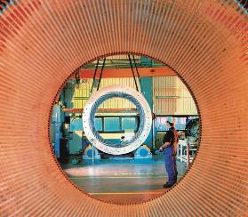






Siemens in Vietnam aligned with the global vision:
“Working to solve what matters.”
Hanoi
Businesses
Smart Infrastructure
Digital Industries
Portfolio Companies
Branch Office
Mobility
*
Siemens Advanta
Binh Duong
Siemens Busway Factory
Ho Chi Minh City
Head Office
* Publicly listed subsidiary of Siemens; Siemens Healthineers with its own setup for Countries and Service & Governance
Notes:
If you see those boxes, you maybe regonized that we are acting behind the scenes, most of our products you will never see but you will live with the end product
Woithout making too much of marketing, important for us is to leave a impact, me and my team have the ambition to working on projects to solve matters
And if you read those boxes maybe you can see that these are the fundamental system of a sociality: healthcare=, transportant, production of goods, energy generation
I work in the box digitalindustries, and today we are talking about a trend in this field, which is used very inflationary but very much not deeply understand

Slide 3
Changing market drivers will influence the manufacturing industry continuously
2021
2030
Time to market
Reduced time to market
Time intensive
Instant delivery
Engagement
Shift to consumer-oriented services
Product
Solution
Visibility
Ability to track behind the scenes
Limited
Across value chain
Production
Personalized solutions at scale
Mass
Personalized
Engagement
Competitive advantage
Convince by sustainable quality
Death of loyalty
Standardization
Zero-defect delivery
Error-prone
Zero defects
Changes in the B2C market are bleeding over to the B2B market

Slide 4

Digital Industries connects the virtual and the real worlds over the entire lifecycle – for discrete and process industries
Green
Petrol
Virtual
world
Performance data
Real
world
Mitte
Realize and optimize

Slide 5
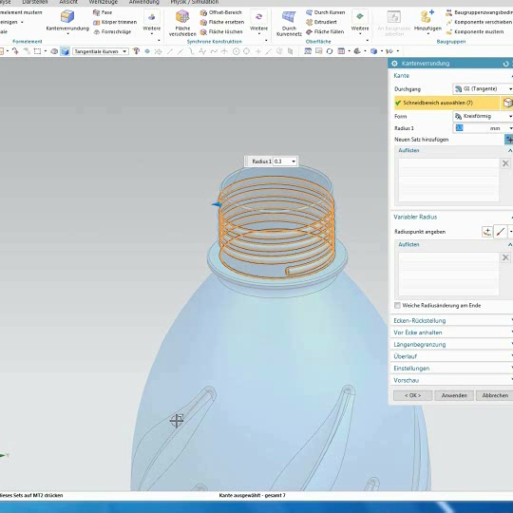
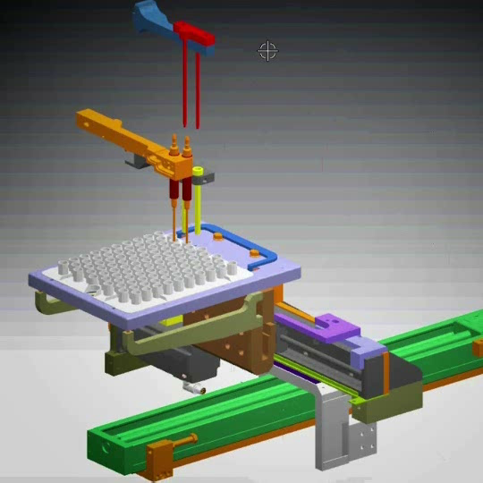
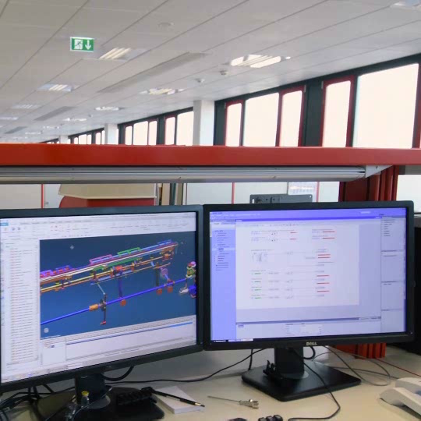
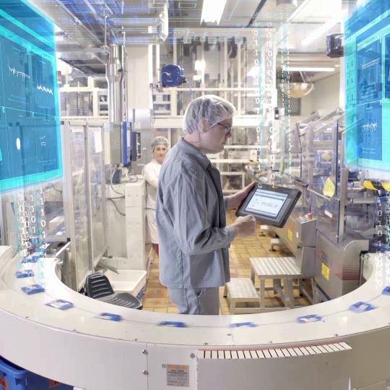
Digital Enterprise:
The basis for continuous optimization
Digital Twin
Product
Digital Twin
Production
Digital Twin
Performance
Green
Petrol
Green
Petrol
Performance data
Mitte
Virtual
product
Virtual
production
Real
production
Automation
Real
product
Realize and optimize
Collaboration platform
Industrial security

Slide 6

















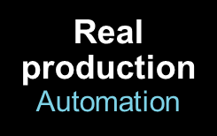


Siemens enables the horizontal integration of Digital Twins along the entire value chain
Digital Twin
Product
Digital Twin
Production
Digital Twin
Performance
Horizontal integration

Slide 7









Driving the Industrial IOT by vertically integrating OT and IT
w
Information
Technology
(IT)
Digital Twin
Product
Digital Twin
Production
Digital Twin
Performance
Operation
Technology
(OT)

Slide 8



Vertical integration – based on Edge, MindSphere, and Mendix low-code app development
w
Cloud / MindSphere
Low-code app development
Communication platforms
Cybersecurity
Information
Technology
(IT)
MindSphere
Software for vertical integration
00101110
11010101
00101011
11011100
00101110
00101110
11010101
00101011
11011100
00101110
Digital Twin
Product
Digital Twin
Production
00101110
11010101
00101011
11011100
00101110
Digital Twin
Performance
00101110
11010101
00101011
11011100
00101110
00101110
11010101
00101011
11011100
00101110
00101110
11010101
00101011
11011100
00101110
00101110
11010101
00101011
11011100
00101110
Industrial Edge
Controller / automation platforms
Operation
Technology
(OT)
Field devices

Slide 9

Digitalization based on Totally Integrated Automation (TIA)
Digital Twin
Product
Digital Twin
Production
Digital Twin
Performance
Performance data
Data acquisition for cloud services
Integrated energy management
Virtual Commissioning
Automatic execution of engineering tasks
Efficient cloud- based engineering
Integrated engineering
of kinematics
Industrial Communication
Analysis of
drive data
Line integration
Virtual
product
Virtual
production
Real
production
Automation
Real
product
PLM integration to automation engineering
Automation planning
Edge
computing
Collaborative Automation design
Artificial intelligence
Virtual training
Realize and optimize
Collaboration platform
Industrial Security

Slide 10

Covid has hit industries differently. The highest impact are projected on industries related to travel and mobility.
Automotive
Machinery
Utilities
Dramatic decline in output
Outlook: transformation towards carbon free e-mobility
Dramatic drop, longer cycles
Outlook: supply chain changes, automation, robotics
Limited impact for utilities
Outlook: renewables, digital grid benefit from stimulus
Oil & Gas
Healthcare & Medtech
Food & Beverage
Dramatic drop in oil price
Outlook: accelerating decline of the oil age
COVID demand but negative impact on hospital P&Ls
Outlook: positive, e.g. digital health, invest in health systems
Resilient, limited impact except restaurant / bar-related
Outlook: relatively stable given overall economy
Mobility & Logistics
Infrastructure
Pharma
Drop in passengers, volumes
Outlook: positive for ecommerce, warehouses;
negative: air travel & aerospace
Low-moderate impact
Upside: digital infrastructure, fiscal stimulus programs
Resilient, limited impact (except supply chain, referrals)
Outlook: potential re-localization, vaccines, digital health
Page 10
Impact on sales volume
High
Mid
Low
Source: Analysis Siemens Advanta Consulting
Notes:
You can see different industries, impact on sales volume in color, but there are of course many more

Slide 11
The pandemic enforced regulations to ensure the safety of the factory workers whereas opportunity costs for manufacturers increased
At vero eos et
accusam
Shortage of (skilled) worker
Only plants in low-risk areas to operate; increased resignation
Shortage of material
1st and 2nd Tier supplier w/ same difficulties, accelerated by steel and chip shortage
Limited personal contact
Social distancing measures for workers applying the “3-on-site”
Projects on-hold
Commissioning and testing activities delayed as missing staff
Mental health
Decrease motivation due to isolation and “away from home syndrome”
Production ramp-up
Smooth ramp-up processes are unclear due to missing labor
Notes:
Covid slide: manufacturing stop causes supply chain desaster, ending up in delays and high shipment and material cost resulting in 13 years high inflation , meaning it reduces, for you and me it means our purchasing power shrink and prices go up
Ramp up hireng new people who nerd to get familiar with mavhines
Simulate to plan your new cycle times cycle time which you then can communicate to your sales team at what time we estimate to be able to deliver produce
Well but every problem has a solution. We have witnesses that companies who use technology where able to reduce these issues (next slide)

Slide 12
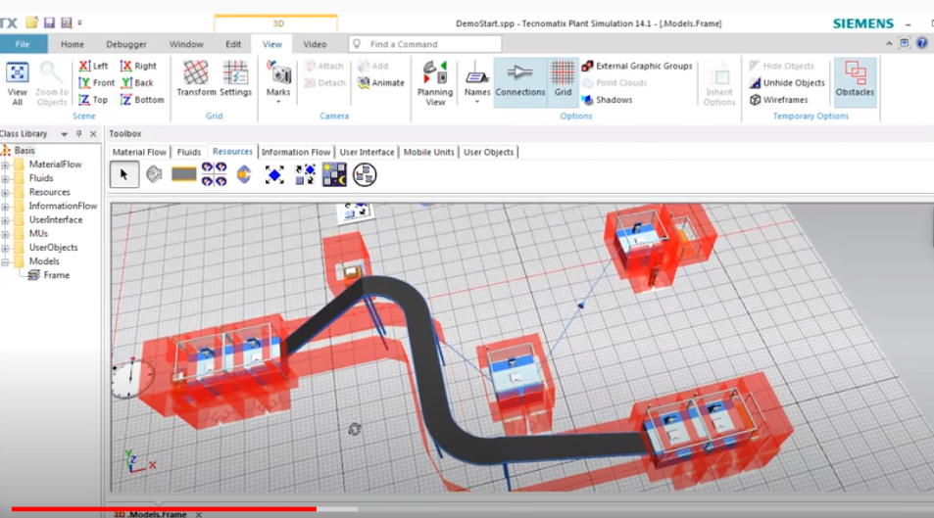
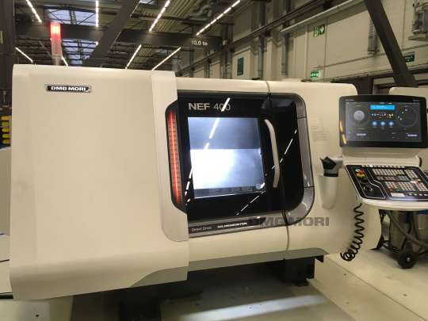
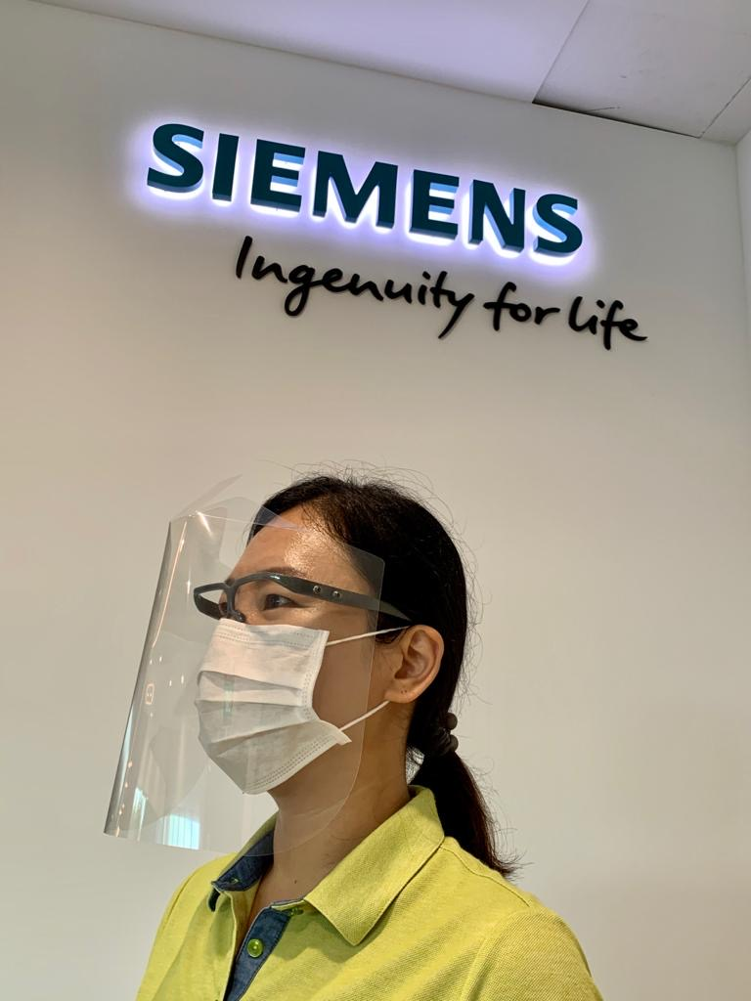
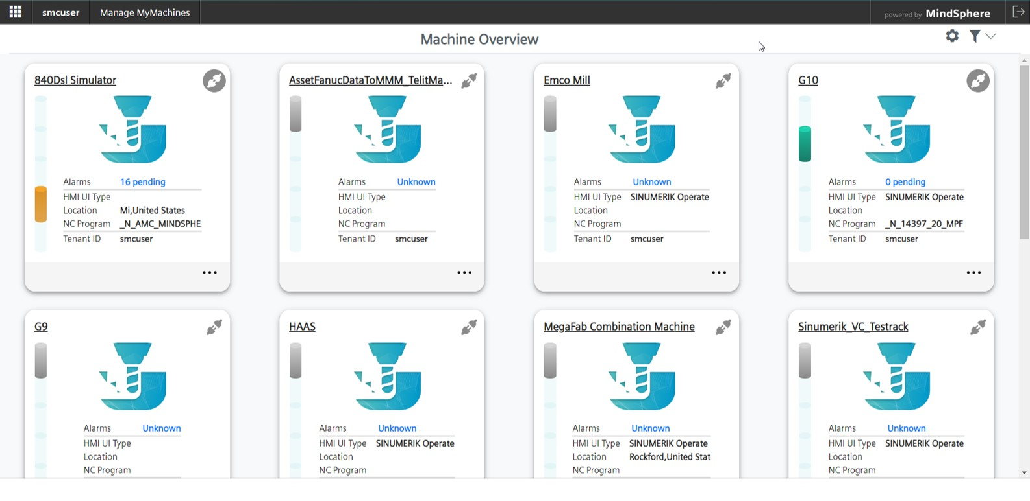
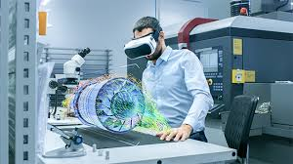
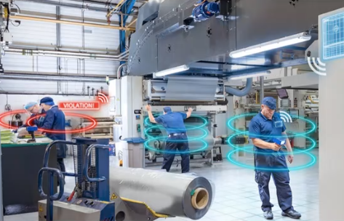
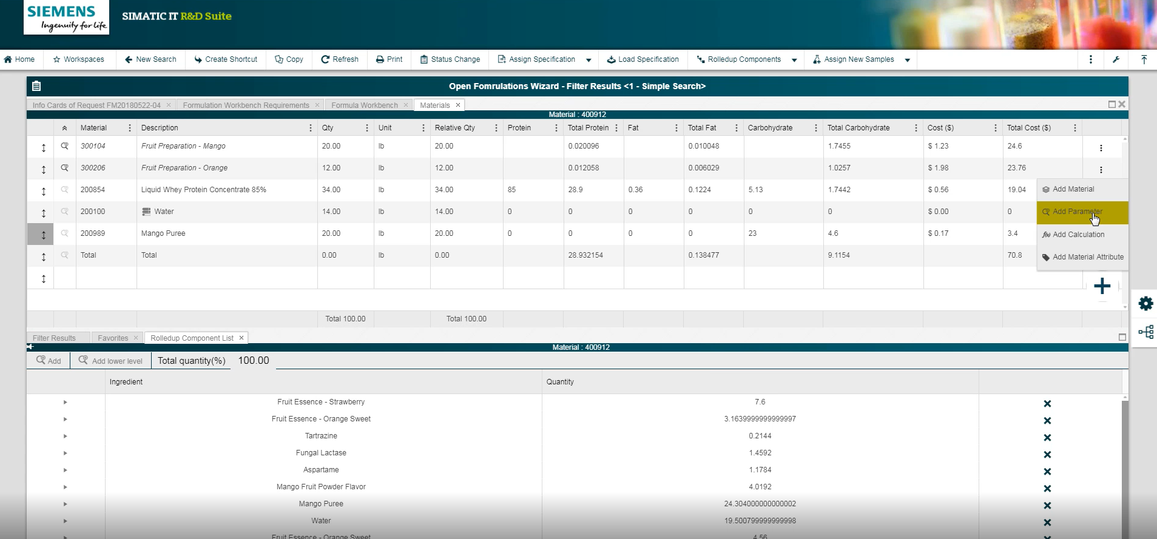
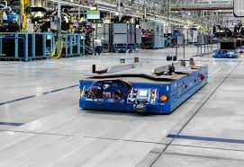
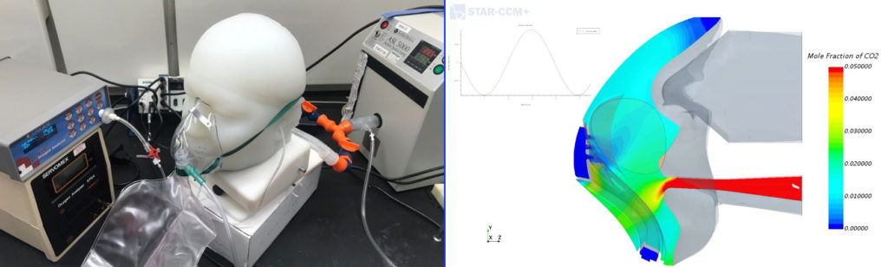
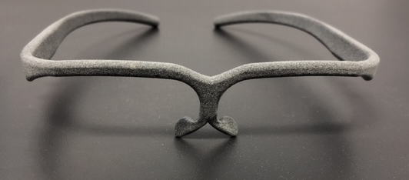
Covid has been a catalyst for technology adaption and accelerated the execution of digitalization plans of CIO’s and production manager
Remote control
Smart glasses
Real-time
location &
Paperless
production
Automated
vehicles
3D printing
Digital twin
OEE monitoring of drilling and milling machines via
dashboard (web access) for plant manager.
Microsoft HoloLens to (re)train and test on-site engineers using 3D model design of CAD file from a press machine.
Maintenance work guided by supplier remotely.
Social distancing monitoring by tracker carried by
worker (normally used to track forklifts).
Infection chain of staff can be traced using the historical data captured.
Eliminate paper-based batch reporting and physical management approvals by using manufacturing execution system.
Originally implemented to speed-up and optimize the material flow. AGV help to reduce personal interaction between logistic team and line worker within the body shop.
3D printers were being used to prototype face shield protectors.
Increased 3D volume by more than 10X (200 to 3000units /printer/month)
Reconfigured the production line to accommodate social distancing for assembly staff.
Simulate air flow and mole fraction of ventilator mask.
Electronics
Automotive
Food & Beverage
Cosmetics
Automotive
Hospital
Healthcare*
*Airbus factory floor converted to Ventilator production
Notes:
Some of projects where already on the roadmap and executed earlier as the circumstances require that due to absence of key persons onsite
But even if they already have some of these examples on a plan it bring a very big benefit during the pandemic vs companies who doesn’t have a plant and in some cases completely needed to shut down the factory
We

Slide 13
Manufacturers in ASEAN are not confident in adopting Digitalization
44%
# of companies who claim to have digitalization
strategies
Majority of manufacturing organizations acknowledge the need for modernization through Digitalization
A signification percentage taking steps to tackle digital transformation internally
A low percentage of digital CAPEX allocation indicates low confidence in their action plans
11%
Of companies actually have budgets allocated for Digitalization
Source: Siemens Analysis
Notes:
Budget Concerns in Vietnam:
Seeing a clear return on investment and priority plan
Lack of standards and 3.0 base
Insuficient skills in labor market
Data security
But we can see an improvmenet in engagement for digital projects
According to PwC:
Investment spendiings (9% of annual revenue) going up to 22% as more companies are affected by industry 4.0
Lukas einleiten

Slide 14
Digitalization
changes
everything?
”
The next trillion dollars will be
earned with data – for our customers and for our industries.
Michael Dell, founder of Dell Inc.
”
Digital is the main reason just over half of the companies on the Fortune 500 have disappeared since the year 2000.
Pierre Nanterme, CEO Accenture
”
If you digitize a shitty process, then you’ll end up with a shitty digital process.
Thorsten Dirks, former Lufthansa Board of Directors

Slide 15
A digital transformation is supposed to support the company’s key performance indicators and create new business models to stay competitive
Productivity
Asset & Equipment Efficiency (OEE)
Inventory Efficiency
Materials Efficiency
Utilities Efficiency
Workforce Efficiency
Flexibility
Planning & Scheduling Effectiveness
Production Flexibility
Workforce Flexibility
KPIs
In manufacturing
Speed
Time to Market
Time to Delivery
Quality
Product Quality
Process Quality
Safety (EHS)
(Cyber) Security
Notes:
One example is the triangle dilemma between production, loigistic, finance. These KPI for each of the body can be addressed by I.490

Slide 16



Digitalization is a journey, which requires a sequence order of steps from planning over execution to optimization
Holistic transformation approach
Management Consultants
System Integrators
Aware
Align
Diagnose
Design
Justify
Purchase
Implement
Optimize
Site visits
Blueprint
Impact Analysis
Arch. Design & Gap analysis
Roadmap
ROI
Governance structure
Analytics
1
1
0
1
1
1
1
0
1
0
1
0
1
0
1
1
0
1
1
1
1
0
0
1
0
1
1
0
0
0
1
0
1
0
0
1
1
0
Notes:
Get a pictzrr of you current sidutation thats avsolotely pre condition
Low hanging frzits. Communicate it to thr team in. Present the benefits sonthat they over thr time can see a evulotion of the project. The more they talk good abt it the better it is.
Blueprint
Famous ROI : armotisation of your initial investments of digital projects
Change management. Digi only works when u have commitment of people using it and the buy in of top level
Start small and look for scale potential in other plants
Lucas: what do you think
Change menegemrnt can be as simple as a training series or presentqtion from your c level to get commitemrnt, i also had customer where he celebrated the rollout of mes with the whole company as a celebration party woth booking a hotel conferenc eroom ... 30 tdchnical amd 70 % is human

Slide 17
16 dimensions to be ranked using a bandwidth from 0 (non-existent) to 5 (very mature) to get a current status of your “digital readiness”
Step 1/3: Rate your dimensions
Process
Technology
Organization
Operations
Supply
Chain
Product
Lifecycle
Automation
Connectivity
Intelligence
Talent
Readiness
Structure &
Management
1
2
3
4
7
10
13
Workforce
&
Learning
15
Shopfloor
Inter- and – Intra
Company
Collaboration
Vertical
Integration
Horizontal
Integration
Integrated
Product
Lifecycle
5
8
11
Enterprise
14
16
6
9
12
Leadership
Competence
Strategy &
Governance
Facility
| 6. Guidance for manufacturers to start their own digitalization journey
Notes:
Phase 1 is the scoring of dimensions
If you want to know what dimension has the highest impact to start invest in you need to conider more parameneter: cost, KPI and benchmark

Slide 18
12 manufacturing industries can be categorized after a natural habitat
Maturity
High
Rainforest
Coniferous Forest
Semiconductors
Pharmaceutica
Energy
Maturity
A measure of how an industry performed in the assessment
Medical
Technology
Chemicals
Electronics
Logistics
Variance
A measure of how companies’ score deviate from the mean within their industry
Precision
Engineering
Aerospace
General
Manufacturing
Marine &
Offshore Engineering
Food &
Beverage
Low
Savanna
Tundra
Variance
High
Low
Source: SIRI Analysis based on >300 manufacturer assessments
Notes:
Rainforest
A lot of different and big trees and plants from different families
Companies in this block are far ahead: e.g. semiconductor with the highest siri maturity
Coniferous Forest
A forest with big trees but all of them look the same
Technologie intesnse but heavily regulated
So what? Government should not regulate and limited the innovation of these companies. These companies are kind of role models in the I4.0 movement
Savanna
Dry area with a few plant and trees
We see potential that these companies can move to rainforest such as F&B who often have a sound automation base (scada systems, PLC etc) to build up on digitalization use cases
Tundray
Dester like wind and less rain – ranked low in both
Areospace and oil for example: high variance and low quantity production. That limited the opp to invest In automation and digi for production scale. However, potential in improvement lie in the process on organization block

Slide 19
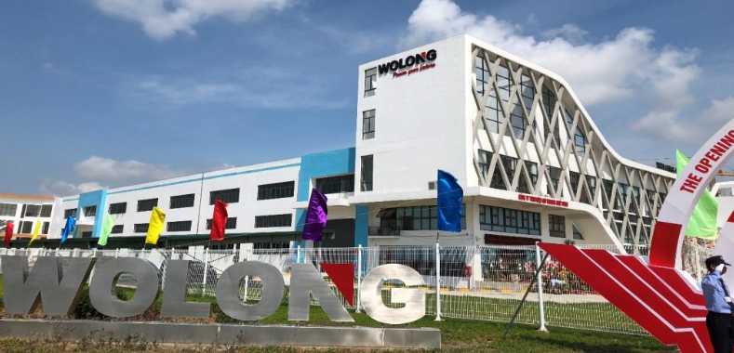



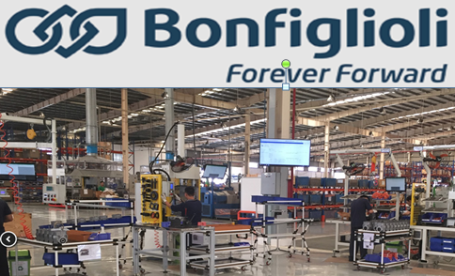

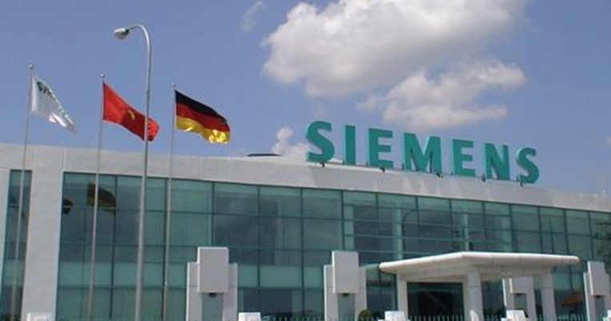
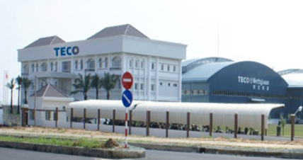



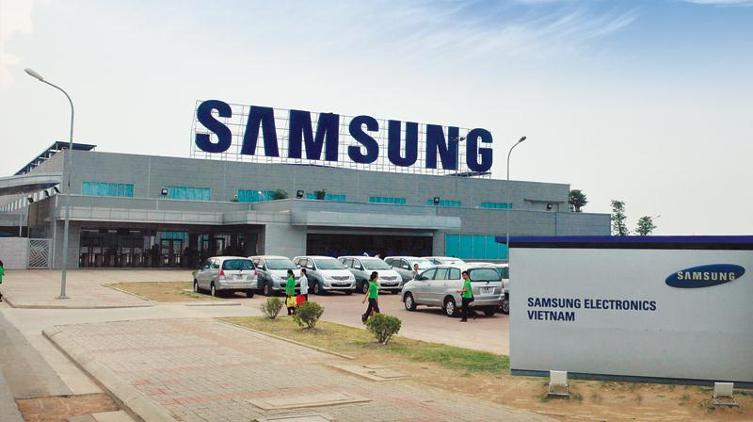
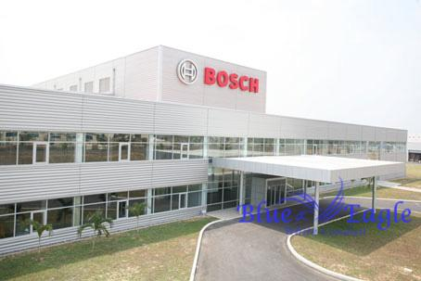
Vietnam initiated several programs by different government bodies to boost the industry 4.0 development across the country
  Vietnam Industry 4.0 Market Size in USD¹
+17%CAGR
300m
92m
2018
2025
  ¹ Pre-COVID forecast
  Source: Universal Robots
Major indicators for increasing I4.0 awareness ²
Legend:
Manufacturing Hub
Engineering Hub
Assembly Center
Political
  Enforcement of national Industry 4.0 Strategy by MPI and approval of Digital Transformation Program (July 2020)
Economical
  Expected to growth in: FDI investment, Consumption, Export, Per Capital Income, GDP/ capita
Social / Infrastructure
  Supply of “digital” workforce to increase by Thu Duc City Hi-Tech Hub and FDI locating R&D efforts (Samsung, Piaggio, GE, Panasonic and more)
Page 19
  ² Source: MPI, MoIT
Notes:
Like the majorities of companies lot of companies here are still in the transmission of I2.0 and 3.0
Vietnam has still some major industries which are very labor intense such as garment and textile food processing but also electronics . Since since are labour intensive industry, overall production is directly proportional to their workforce efficiency. At the moments for customer we don’t see much investment in I.4.0 due to reasons such as cost benefit of cheap labor and not seeing the benefit right away, especially when they are government related
Maybe Lukas you can share.
We have seen In the reports we have done for around 20 customer are major lacks) connectivity mostlye between 0-1
old machines, where sometimes the service or productr manager doesn’t live anymore
Machines from differert vendors which only support their communication protocole
A reason is that most of these companies either relocated their old machines from abroad to vietnam to produce here and enjoy the cost benefit, a lot of companies also buy second hand machines from korea or china and Germany
Those you are mature are elerctronics, automotive and supplier (FDI and greenfield plants - Also food and beverage and food processing and tyre is a increase in adoption to build up a data foundation for prediction models

Slide 20
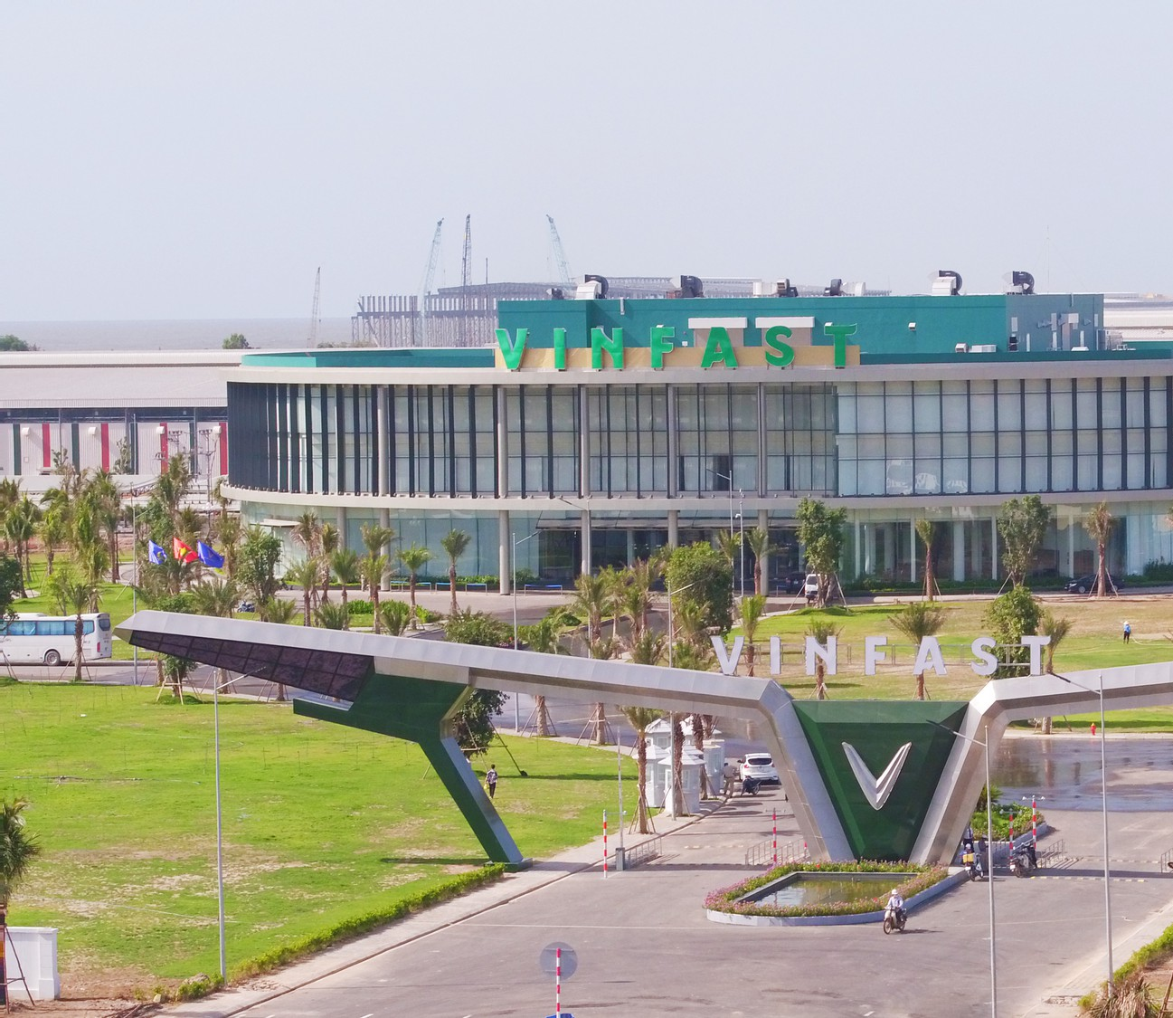
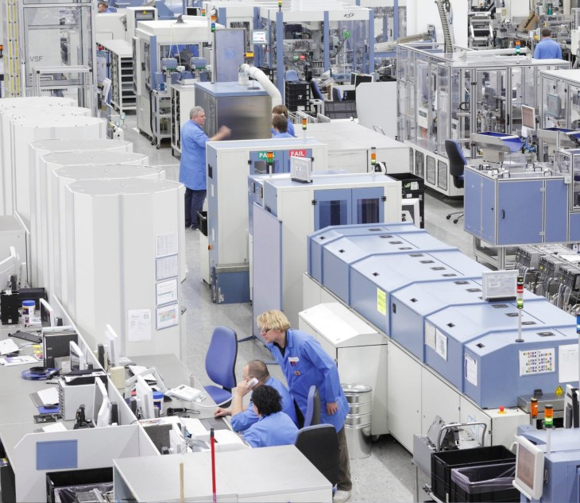


Greenfield project: arguably easier to built up a smart factory from scratch because you don’t built on legay technologies
Siemens “4.0 Electronic Works” Factory
Brownfield adapting I4.0 over the time
Amberg, Germany
>120 different product / day (average 1 product per minute)
~ 350 changes / day (equivalent to 1200 different products variants)
9x increase in manufacturing output since 2017 (SINAMICS)
25% shorter time-to-market of new products from 20 months to 15 months
~ 7 days ready-for-delivery instead of 25 days
Page 20
| 6. Guidance for manufacturers to start their own digitalization journey
Notes:
Example brownfield
Eveb more agv
Mention mindsphere also use in vietnam
When I pitch those technologies to customer they often ask me: do you actually use your own technology in your own factory?
And yes - We deploy our own technologies in our factories to enjoy the benefits of it
First siemens electronics manufacturing plant in Amberg which we product our automation products and precision parts such as circuit boards and computer chips
This a factory which was established in 1989. And since that period of time they have been stable on their 10,000 m2 size. They have never increased their amount of manpower of 1200 employees.
This factory has to make 350 changover on machines to build 120 different of product / day and 1 product / second
what makes it so amazing is that, we have a productivity increase of 13x by using technologies such as mindsphere, Real time location system, flexible robots and 3d printers
this is definitely numbers that a CFO would like to see

Slide 21
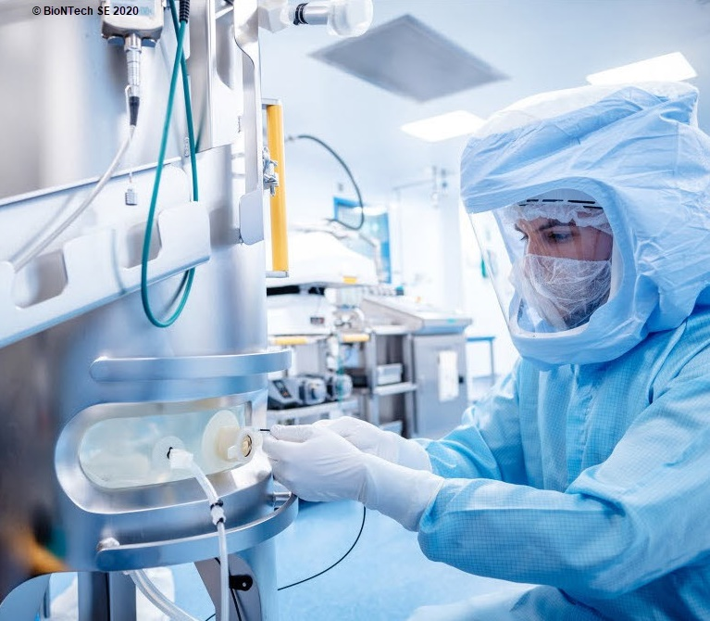
BioNTech
Fast-Track COVID-19 production
Marburg, Germany
Project “Lightspeed” to repurpose a vaccines plant in 6 months
Eliminate paper processes and automated operations with an MES, delivered in 2.5 months
SIMATIC PCS 7 and TIA portal for automated control system and engineering framework
Page 21
Notes:
MES manufacturing execution system is a big module with a lot of sub moduls, the powerful poart of MES in pharma is e.g. batch management….dann ereklaeren
Biontech pfzer vaccin production
Acquired old Novartis factory to extend vacin production
Paperless production to fasten the speed of manufacturiring
Project “Lightspeed” to repurpose a vaccines plant in 5 months.

Slide 22
Contact
Siemens Vietnam
  Le Tien Vinh
Head of Industry 4.0
7th floor, Deutsches Haus
33 Le Duan street, District 1,
Ho Chi Minh City, Vietnam
Mobile : +84 902 586 121
E-mail : le-tien.vinh@siemens.com

